Slide 1

Data Management: Data Bias and Exclusion
Dr Emma Murphy

Slide 2
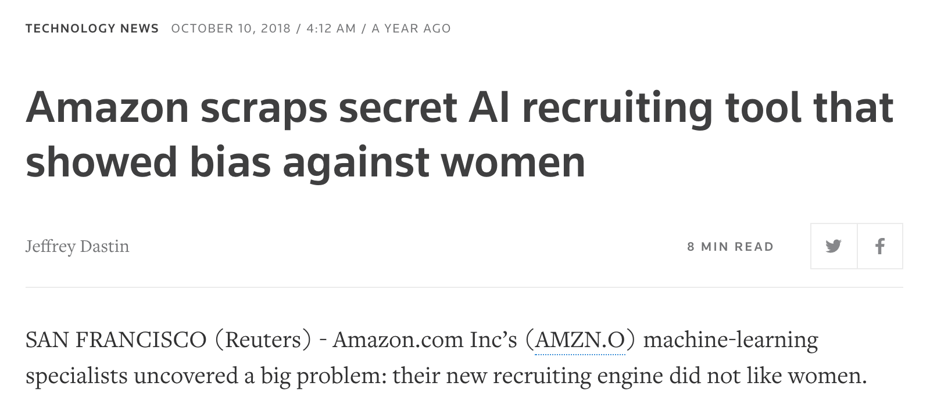
Headlines
…the company realized its new system was not rating candidates for software developer jobs and other technical posts in a gender-neutral way… because Amazon’s computer models were trained to vet applicants by observing patterns in resumes submitted to the company over a 10-year period. Most came from men, a reflection of male dominance across the tech industry….
https://www.reuters.com/article/us-amazon-com-jobs-automation-insight/amazon-scraps-secret-ai-recruiting-tool-that-showed-bias-against-women-idUSKCN1MK08G

Slide 3
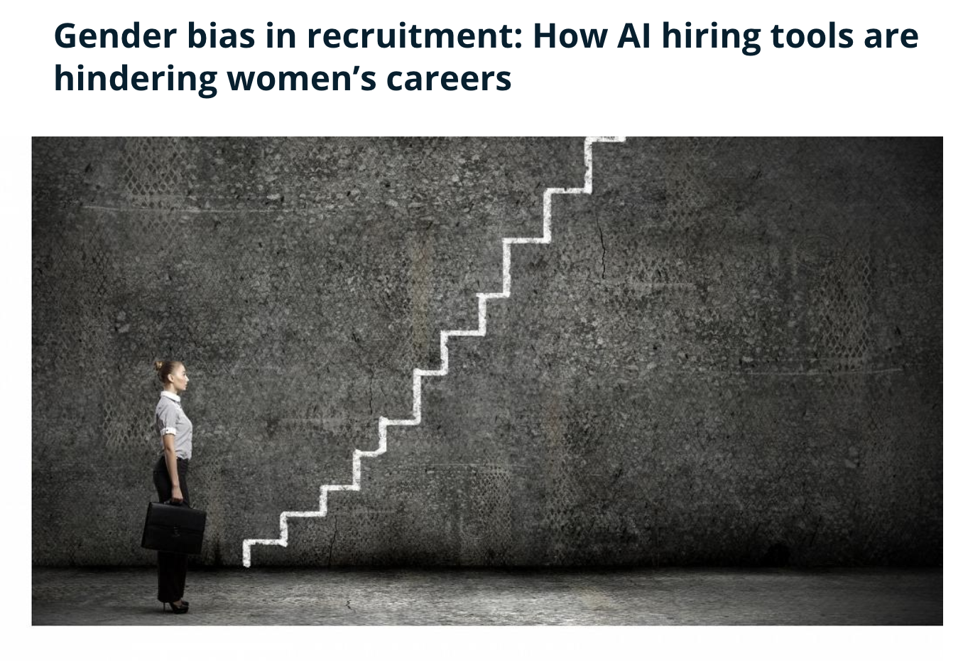
Headlines
https://www.euronews.com/next/2022/03/08/gender-bias-in-recruitment-how-ai-hiring-tools-are-hindering-women-s-careers

Slide 4
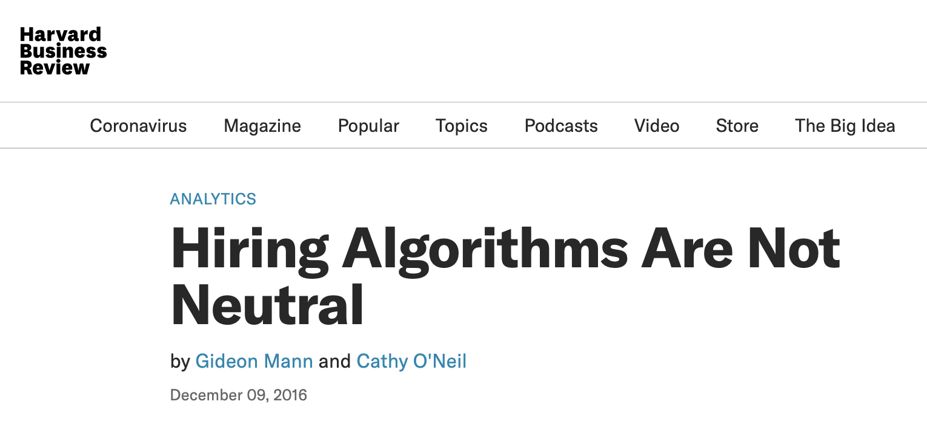
Headlines
When humans build algorithmic screening software, they may unintentionally determine which applicants will be selected or rejected based on outdated information — going back to a time when there were fewer women in the workforce, for example — leading to a legally and morally unacceptable result.
https://hbr.org/2016/12/hiring-algorithms-are-not-neutral

Slide 5
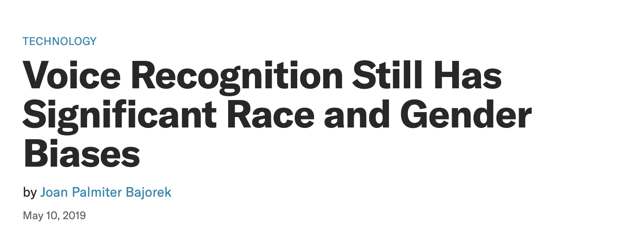
Headlines
Research by Dr. Tatman published by the North American Chapter of the Association for Computational Linguistics (NAACL) indicates that Google’s speech recognition is 13% more accurate for men than it is for women.
https://hbr.org/2019/05/voice-recognition-still-has-significant-race-and-gender-biases

Slide 6
Data and discrimination
Machine learning classifiers train themselves on historical datasets
Any problems with data become problems for the classifiers
These problems lead to exclusion or poor representation or poor performance especially when dealing with minorities

Slide 7
Stages in typical Machine Learning Application
Gather Data
Pre-process Data
Train and Test ML Model
Deploy Model

Slide 8
Areas of Discrimination
Areas of concern where discrimination is possible
Access to Credit
Access to Employment
Access to Higher Education
Criminal Justice
(Obama White House Report, 2016)

Slide 9
Preventing Discrimination
Recommendations
Active Inclusion
Fairness
Right To Understanding
Access to Redress
(World Economic Forum, 2018)

Slide 10
Preventing Discrimination
Active Inclusion: The development and design of ML applications must actively seek a diversity of input, especially of the norms and values of specific populations affected by the output of AI systems.
(World Economic Forum, 2018)

Slide 11
Preventing Discrimination
Fairness: People involved in conceptualizing, developing, and implementing machine learning systems should consider which definition of fairness best applies to their context and application, and prioritize it in the architecture of the machine learning system and its evaluation metrics.
(World Economic Forum, 2018)

Slide 12
Preventing Discrimination
Right to Understanding: Involvement of ML systems in decision-making that affects individual rights must be disclosed, and the systems must be able to provide an explanation of their decision-making that is understandable to end users and reviewable by a competent human authority. Where this is impossible and rights are at stake, leaders in the design, deployment and regulation of ML technology must question whether or not it should be used. –
(World Economic Forum, 2018)

Slide 13
Preventing Discrimination
Access to Redress: Leaders, designers and developers of ML systems are responsible for identifying the potential negative human rights impacts of their systems. They must make visible avenues for redress for those affected by disparate impacts, and establish processes for the timely redress of any discriminatory outputs
(World Economic Forum, 2018)

Slide 14
Technologies that exclude
Even though we have decades of work already identifying people who are at risk of discrimination (for example people with disabilities, women, racial minorities)
And have created laws to protect them,
We are still creating technologies that exclude or amplify bias against at risk groups.
Notes:
Norman’s perspective on Human Centred Design begins with a commitment to the full diversity of human experience

Slide 15
Technology and Exclusion
Understand how people can be left behind or excluded from data and technical systems
how we can try to overcome this to build genuinely inclusive human centred technologies.

Slide 16
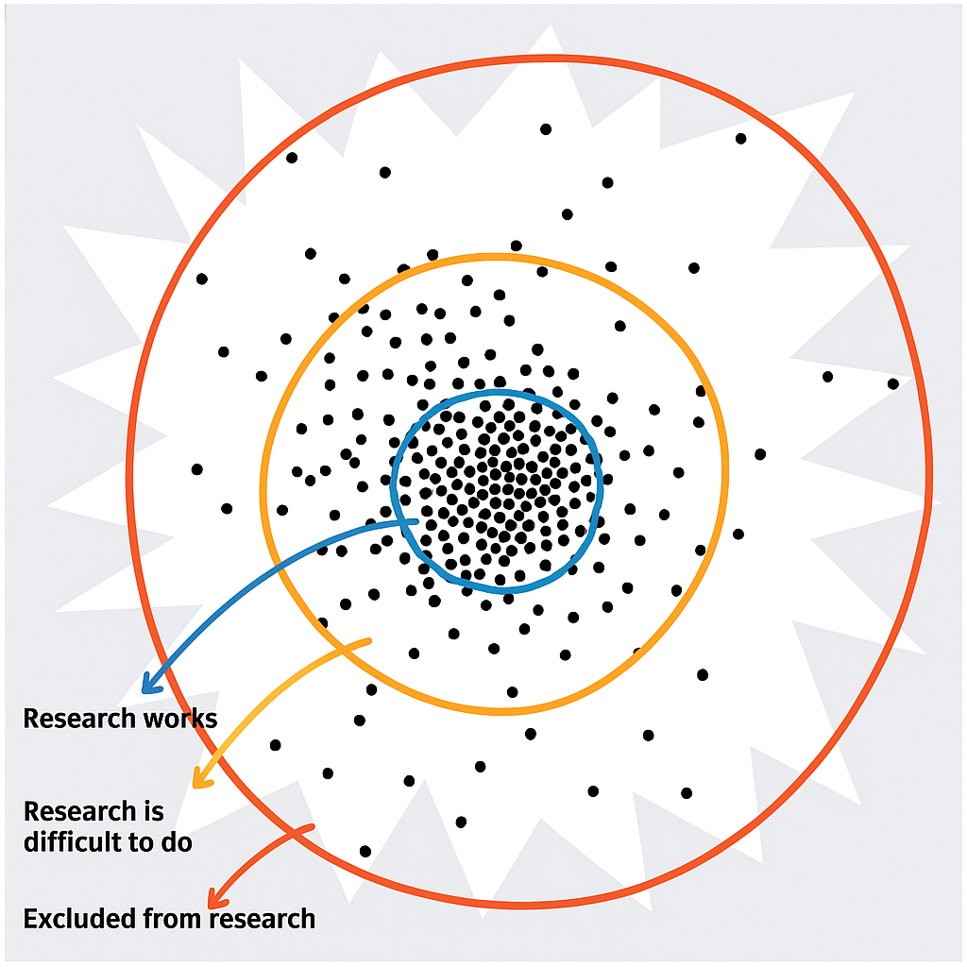
People are different
People are not all the same
By focusing on similarity and the majority we risk excluding people at the margins
Or identifying people who are different as outliers
Notes:
In order to understand how exclusion occurs we need to acknowledge and recognize that people are not all the same

Slide 17
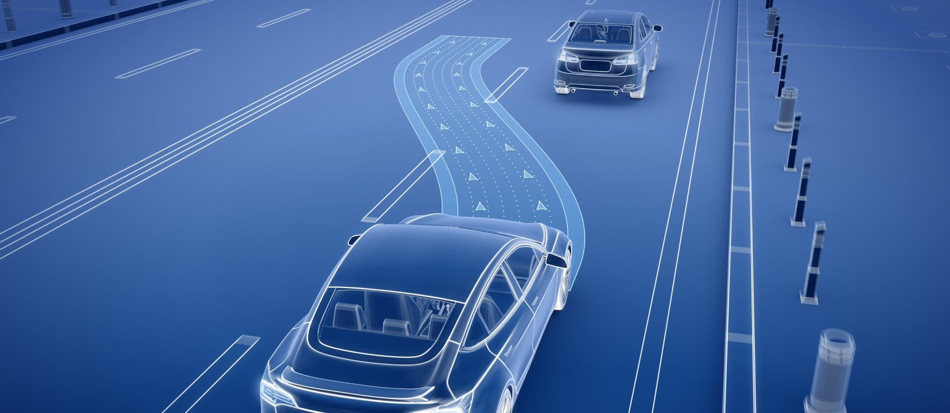
Data, Exclusion and Outliers
Accessibility Researcher Jutta Treviranus tells of her experience testing autonomous driving models in the Department of Transportation in Canada
She was observing machine‑learning models designed to guide driverless cars.
Curious, she tested how these systems reacted to people who move in atypical ways.
Notes:
To understand the issues around exclusion and minorities in data Accessibility Researcher Jutta Treviranus has an insightful anecdote about her experience testing autonomous driving models in the Department of Transportation in Canada

Slide 18

Data, Exclusion and Outliers
She used footage of a friend who propels herself rapidly backwards in a wheelchair.
The models repeatedly classified her as an object to be driven over—making the assumption that she would move forwards
After being “improved” with more wheelchair data. Instead of learning to recognise her, the systems simply became more confident in their mistake.

Slide 19
Bias and Exclusion
“While machine learning allows computers to make their own decisions, those decisions are essentially coloured by the data we provide them with… Our research is not very supportive to diversity, and we have basically transferred that to machine learning.” Jutta Treviranus, Director of the Inclusive Design Research Centre, OCAD University
https://www.cbc.ca/radio/spark/362-machine-learning-outliers-smart-device-ownership-and-more-1.4279433/ai-s-problem-with-disability-and-diversity-1.4279444

Slide 20
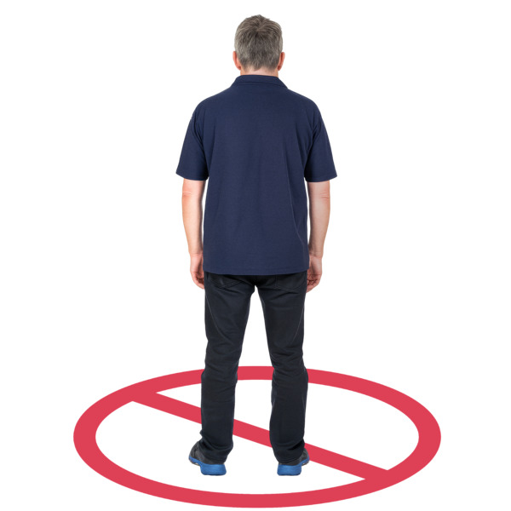
Exclusion and Research
Our research systems often struggle to include diversity and complexity.
When we collect and reuse data that leaves out people who are different, we keep excluding people who are in the minority.
This problem becomes even bigger when we use that data to for AI

Slide 21
Problems for Minorities in AI
Under-represented, misrepresented or excluded from data sets
Issues related to probabilistic models lean towards the majority - where people who present differently may be overwhelmed by the majority

Slide 22
So what can we do?
Inclusivity: If we include people with lived experience on research teams, we can:
Make sure data is collected in ways that are accessible and inclusive
Reflexivity: think about who we are as researchers to understand our viewpoint and how it may be different to the information, the context, and the viewpoints of people who present differently in data
Notes:
What I want to propose today are two research practices that I think are key to addressing issues of bias and exclusion in research

Slide 23
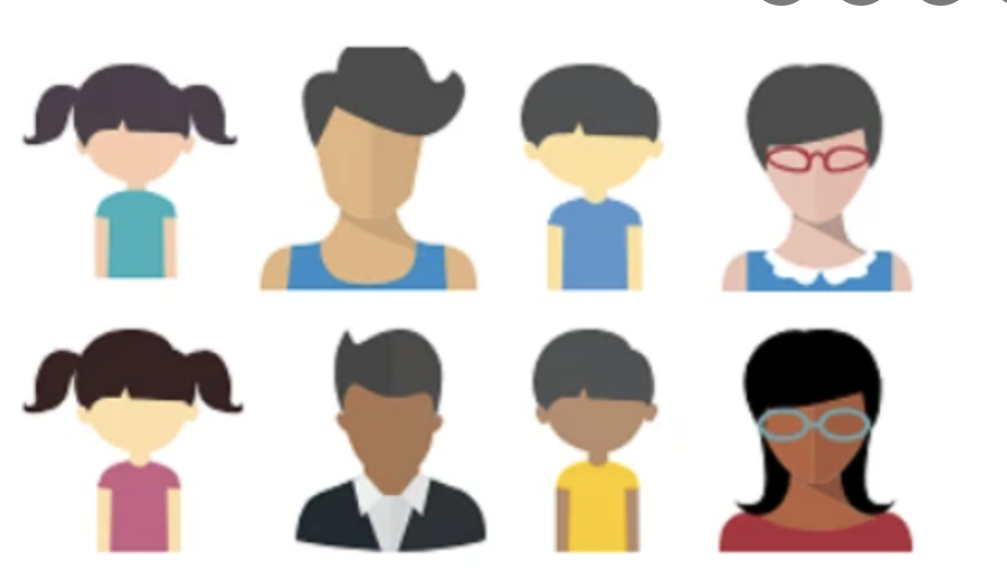
Participatory approaches
Participatory methods such as co-design are an important and recognised approaches in the field of Human Computer Interaction and in software development .

Slide 24
Active Inclusion for AI systems
Active Inclusion: The development and design of ML applications must actively seek a diversity of input, especially of the norms and values of specific populations affected by the output of AI systems.
(WEF, 2018)

Slide 25

Co-Design
Co-Design supports a wide range of people to be creative together and find solutions to a problem.

Slide 26
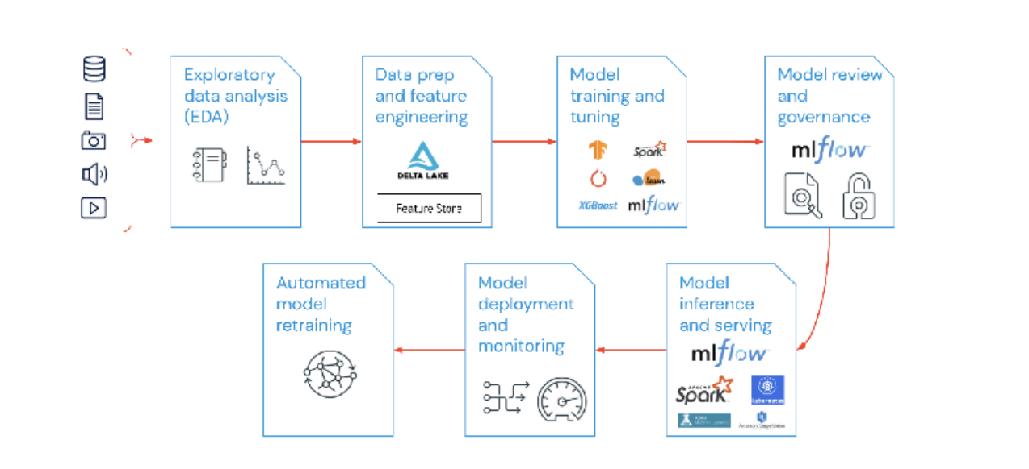
Co-designing AI?
https://www.tudublin.ie/research-innovation/research/discover-our-research/research-centres/towards-people-oriented-technology/people/postgraduate-researchers/tlamelo-makati-.php

Slide 27
Missing the “how”
Researchers and Policy makers are starting to understand “why” it is important to include people with lived experience
BUT
In existing studies the "how" is missing
How can we include participants with lived experience in the design and development of AI?

Slide 28
Challenges
Achieving genuine participation among all stakeholders requires time and resources that are not always available in industry and academic projects.
The way universities do research follows strict rules.
These rules are often not flexible, and not easy for everyone to take part in research.

Slide 29
Research Ethics - “Vulnerable” participants
It can be difficult to gain approval from REC to involve people with ID or cognitive impairments in research due to issues of informed consent and protection from adverse practices of coercion or duress.
If researchers are deterred from including participants in their studies, bias and exclusion issues will be further amplified for this group.

Slide 30
Reflexivity
In qualitative data analysis we are encouraged to reflect on our own point of view, beliefs and assumptions and how that can affect our interpretation and analysis.
But we need to consider how our biases, external constraints (funding, qualifications) could influence our study design, inclusion criteria and recruitment before we even collect data as well as during any data driven lifecycle
Even if we are working with existing datasets we need to consider our point of view to identity and mitigate for bias

Slide 31
Issues for PwD
Issues in datasets
Under-represented or excluded from data sets
Misrepresented by data sets
Inherent bias in data sets
Overwhelmed by the majority
Probabilistic models lean towards the majority

Slide 32
Consequences for PwD
Exclusion e.g from employment or credit or education
Discrimination and loss of civil rights
Policies made on faulty or suspect conclusions due to AI and bad data
Technology not working for them

Slide 33
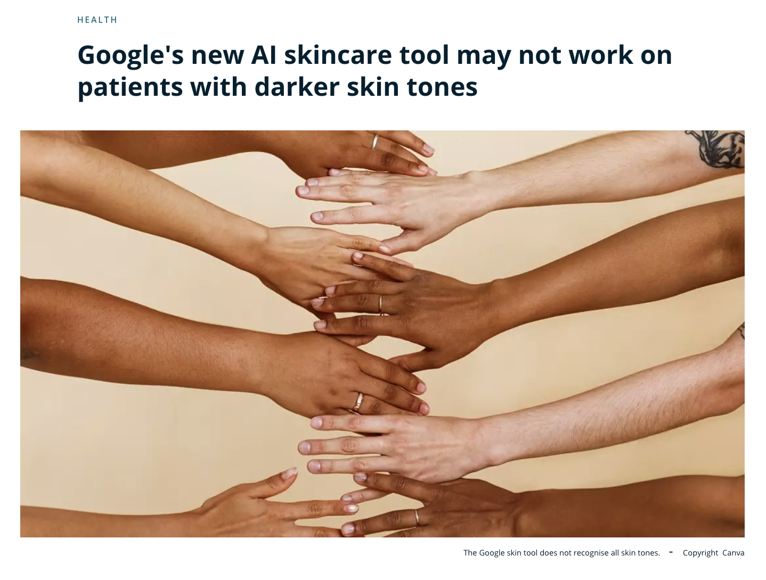
Google AI Skincare tool (2021)

Slide 34
Google AI Skincare tool (2021)
Google unveiled a preview of an AI-powered tool that it says could help identify problems with your skin.
Data used for tool appeared not to include many patients with darker skin types.

Slide 35
Activity
Focus AI skincare example of exclusion and discuss:
Understand: How did the exclusion happen?
How might a company…ensure a more inclusive design next time?
https://www.euronews.com/next/2021/05/26/google-s-new-ai-skincare-tool-may-not-work-on-patients-with-darker-skin-tones

